Slide 1


MATHEMATICS
GRADE 2
YEAR 2
TERM 1

Slide 2
OUTLINE
Duration | Content Area | Topic
Week 1 & 2 | Numbers, Operations and Relationships Data handling | Count forwards in 1s from any number up to 20 Sort concrete objects according different attributes e.g. colour, shape, size
Week 3 | Numbers, Operations and Relationships Measurement | Recognise, identify and read number symbols up to 1-20 Place birthdays on a chart
Week 4 | Numbers, Operations and Relationships Space and shape | Solve simple word problems in context involving, equal sharing and grouping up to 10 Describe, sort and compare 3D objects in terms of: size, colour and shape
Week 5 | Numbers, Operations and Relationships Measurement | Solve simple word problems in context involving addition and subtraction with answers up to 10 Compare and order the mass of two or more objects using a balancing scale
Week 6 | Numbers, Operations and Relationships Data handling | Addition and subtraction up to 10 Use pictures to represent data in pictograph

Slide 3
Outline cont…
Duration | Content Area | Topic
Week 7 | Numbers, Operations and Relationships | Recognise, identify and read number names 1-20 Write number symbols 1-10 Copy and extend simple number sequence to at least 10
Week 8 | Numbers, Operations and Relationships | Describe, compare and order numbers 1-15 and recognise: more, less and equal to
Week 9 | Numbers, Operations and Relationships | Add the same number repeatedly up to 10
Week 10 | Numbers, Operations and Relationships | Recognise and identify the South African coins, R1,R2, R5 and the bank notes R10, R20, R50 and R100

Slide 4
Week 1 & 2
Count forwards in 1s from any number up to 20
Sort concrete objects according different attributes e.g. colour, shape, size

Slide 5
Group 1
Task 1: Colour as you count from 1 all the way to 20
1 | 2 | 3 | 4 | 5 | 6 | 7 | 8 | 9 | 10
11 | 12 | 13 | 14 | 15 | 16 | 17 | 18 | 19 | 20

Slide 6
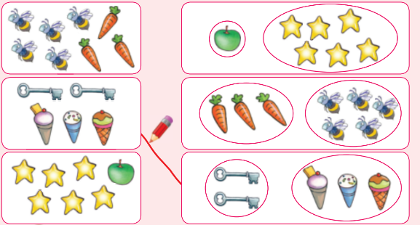
Group 1
Task 2: Match the sorted objects with the picture.

Slide 7
Group 2
Task 1: Trace as you count the numbers from 1 all the way to 20.
1 | 2 | 3 | 4 | 5 | 6 | 7 | 8 | 9 | 10
11 | 12 | 13 | 14 | 15 | 16 | 17 | 18 | 19 | 20

Slide 8
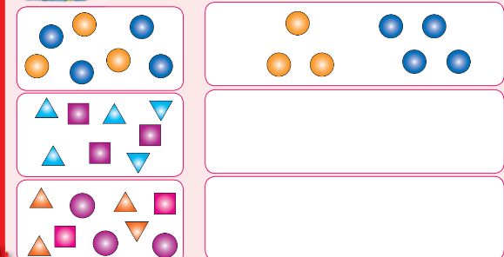
Group 2
Task 2: Sort objects by making a drawing of each.

Slide 9
Group 3
Task 1: Write the numbers from 1 all the way to 20 below.

Slide 10
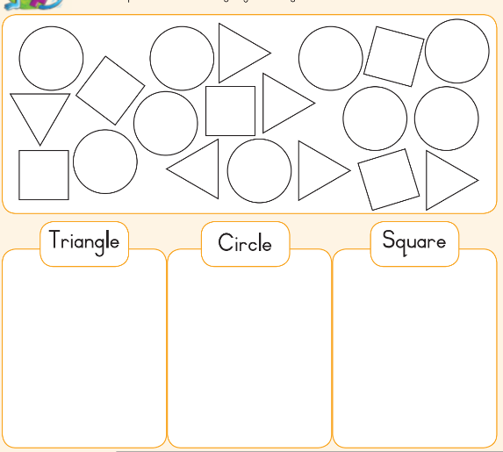
Group 3
Task 1: Sort the shapes and make a drawing of your sorting.

Slide 11
Week 3
Recognise, identify and read number symbols up to 1-20
Place birthdays on a chart

Slide 12
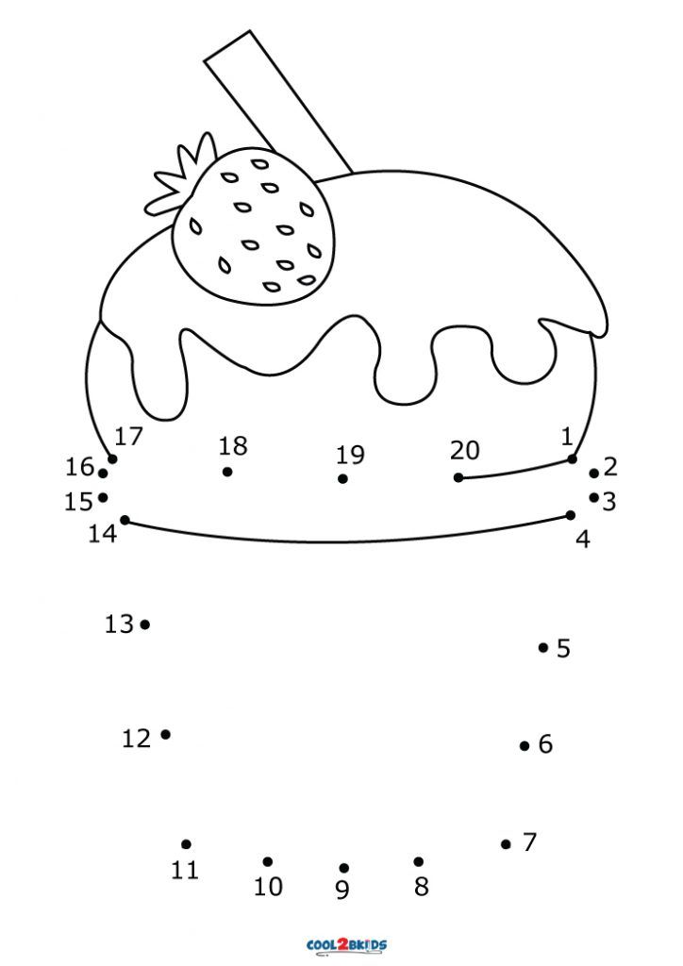
Group 1
Task 1:Connect the dot to complete the animal picture.

Slide 13

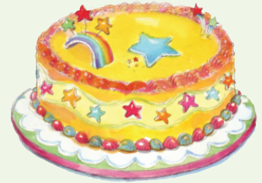
Group 1
Task 2: Look at the picture and talk about how old you are.

Slide 14
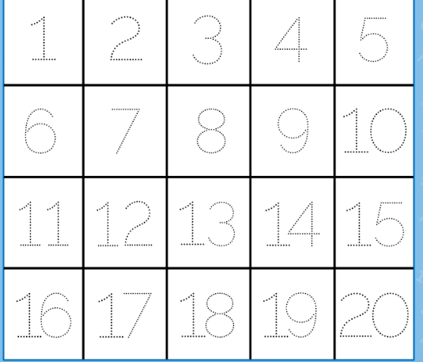
Group 2
Task 1: Trace the numbers from 1 to 20.

Slide 15
Group 2
Task 2: Draw candles on this cake to show how old you are.

Slide 16
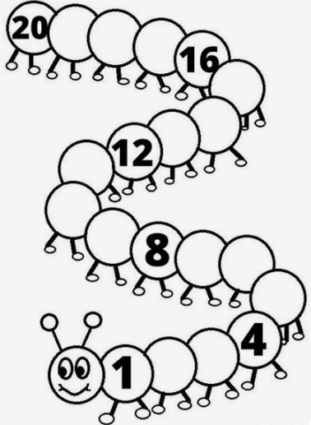
Group 3
Task 1: Fill in the missing number on the caterpillars by counting 1 to 20 .

Slide 17
Group 3
Task 2: Draw a cake with candles to show how old you are.

Slide 18
Week 4
Solve simple word problems in context involving, equal sharing and grouping up to 10
Describe, sort and compare 3D objects in terms of: size, colour and shape

Slide 19
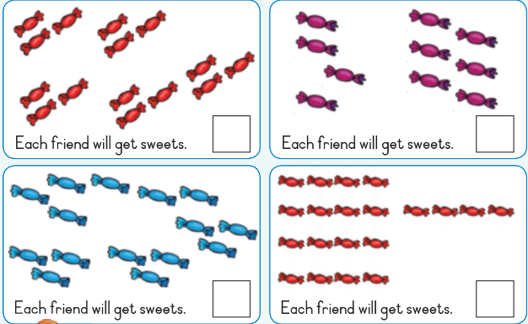
Group 1
Task : Share the sweets between five friends. Say many sweets will each get?

Slide 20
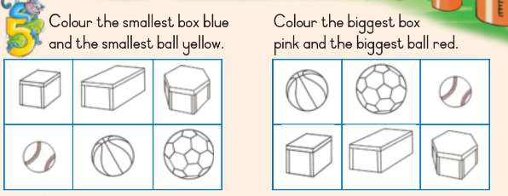
Group 1

Slide 21
Group 2
Task 1: Share the sweets between five friends. How many sweets will each get?

Slide 22
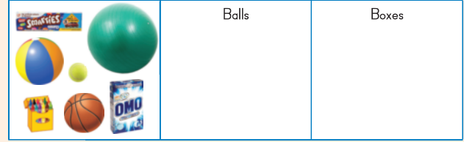
Group 2
Task 2: Sort the following objects by drawing them in the correct block.

Slide 23
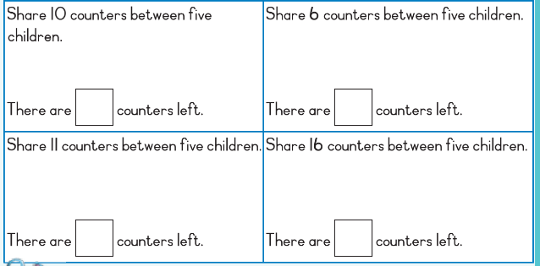
Group 3
Task 1: Circle the fruit and animals to share them equally.

Slide 24
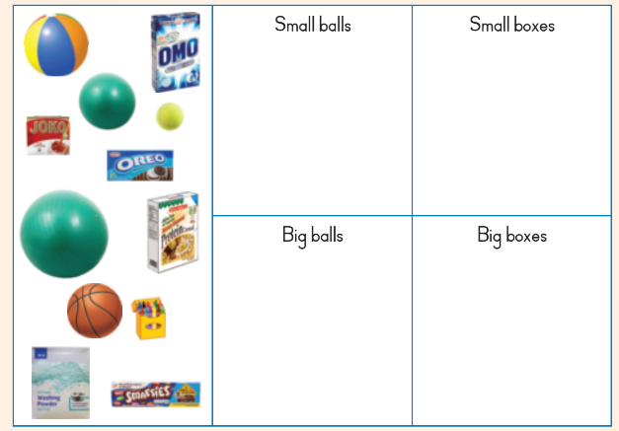
Group 3
Task 2: Sort the objects according to size by drawing them.

Slide 25
Week 5
Solve simple word problems in context involving addition and subtraction with answers up to 10
Compare and order the mass of two or more objects using a balancing scale

Slide 26
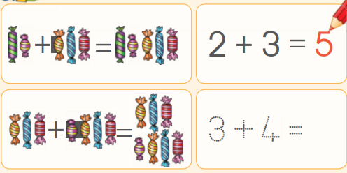
Group 1
Task 1: Add these sweets an d then fill in the answers

Slide 27
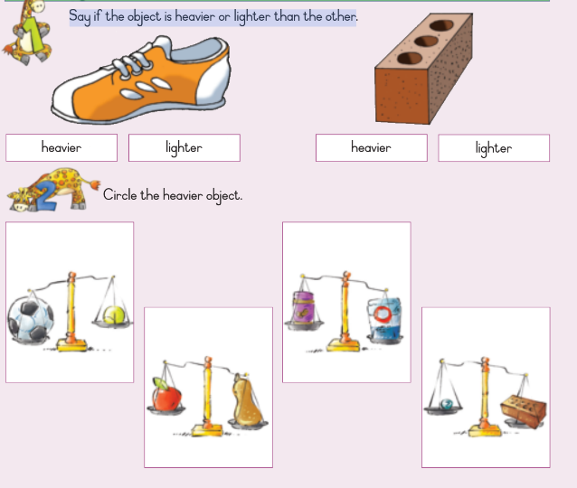
Group 1

Slide 28
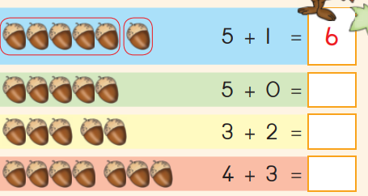
Group 2
Task 1: Add the numbers.

Slide 29
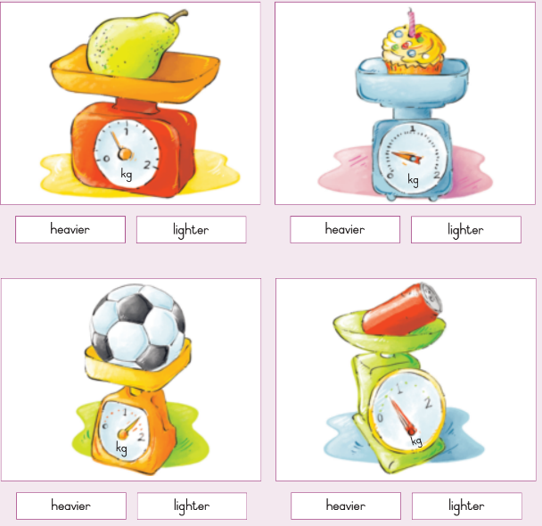
Group 1
Task 2: Is the object heavier or lighter than one kilogram?

Slide 30
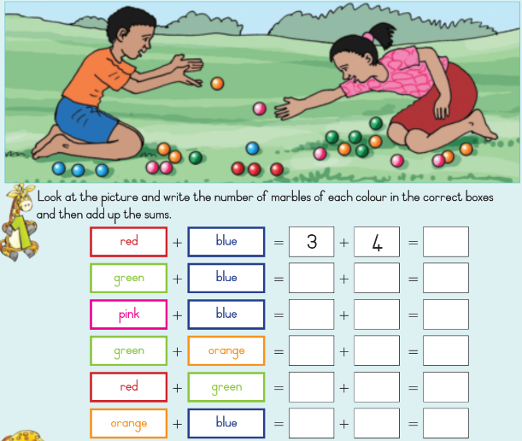
Group 3
Task 1: Add

Slide 31
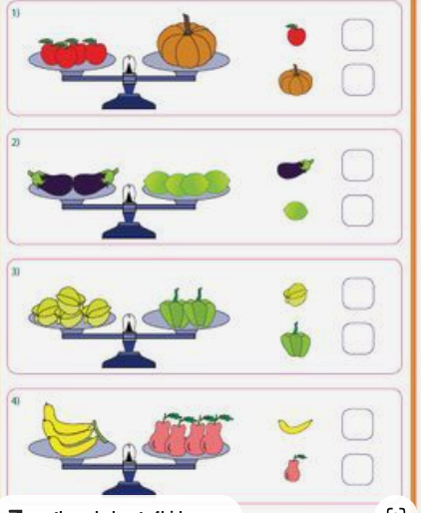
Group 3
Task 1: Tick the heavy one and cross out the light one.

Slide 32
Week 6
Addition and subtraction up to 10
Use pictures to represent data in pictograph

Slide 33
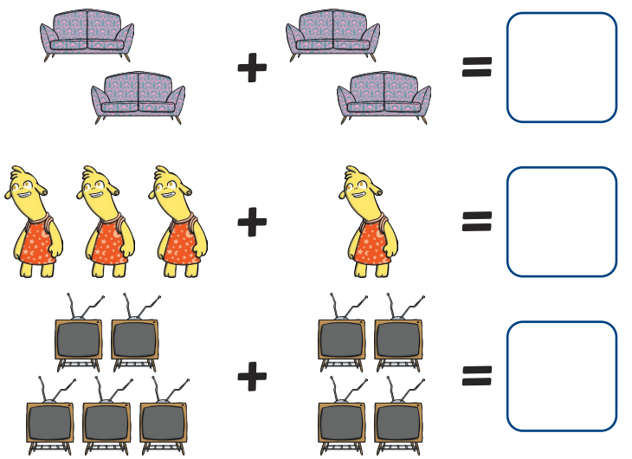
Group 1
Task 1: Count the number of object and write the answers in the boxes.

Slide 34

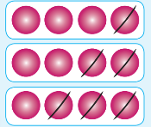
Group 1
Task 2: Count how many counters are left.

Slide 35
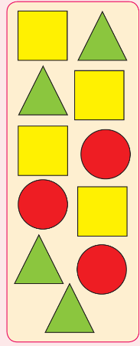
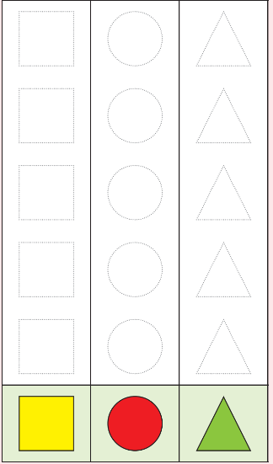
Group 1
Task 3: Cut out the shapes on the left and paste them on the graph on the right.

Slide 36
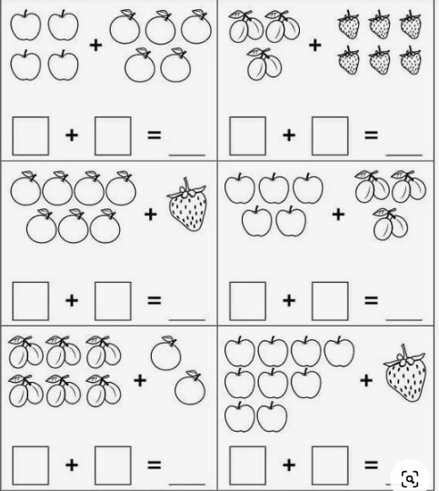
GROUP 2
Task 1: Count each group and solve the addition problem.

Slide 37
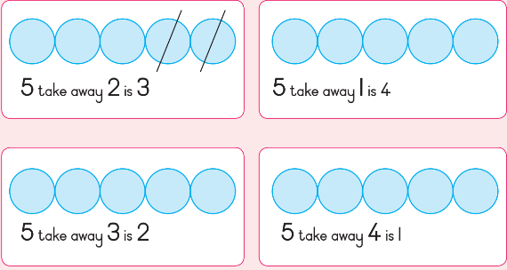
GROUP 2
Task 2: Cross out the beads to show:

Slide 38
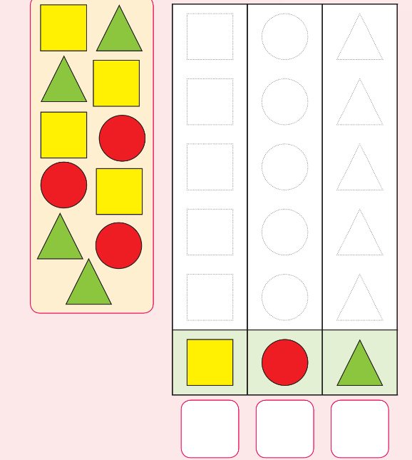
GROUP 3
Task 3: Count the number of different shapes. Then draw and colour the same number of shape in the pictograph.

Slide 39
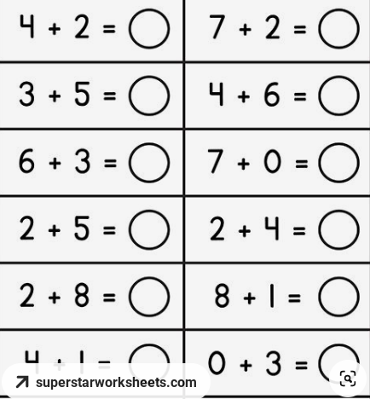
GROUP 3
Task 1: Complete the following number sentence.

Slide 40
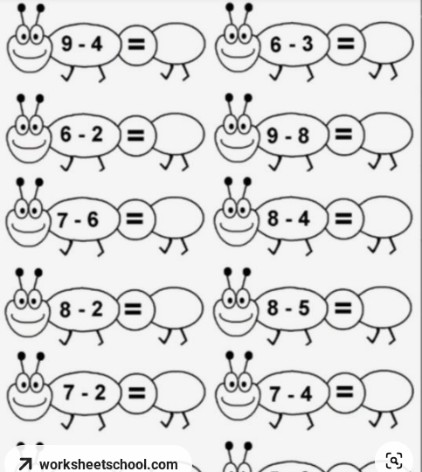
GROUP 3
Task 2: Complete the following number sentence.

Slide 41
GROUP 3
Task 3: Count the number of different shapes. Then draw and colour the same number of shape in the pictograph.

Slide 42
Week 7
Recognise, identify and read number names 1-20
Write number symbols 1-10
Copy and extend simple number sequence to at least 10

Slide 43
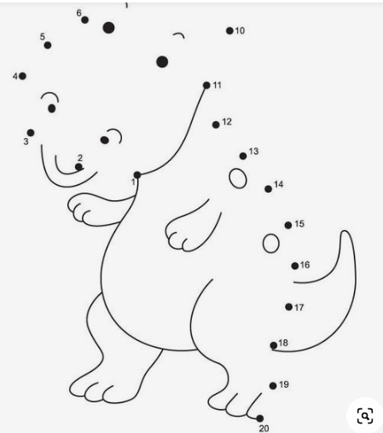
GROUP 1
Task 1: Connect the dot to complete the animal picture.

Slide 44
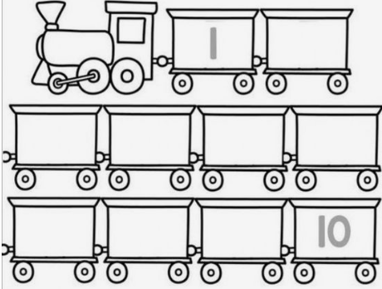
GROUP 1
Task 2: Drag and drop numbers 1 - 10 on the train in a correct order.
2 | 4
3 | 8
7 | 5
10 | 1
6 | 9

Slide 45
GROUP 2
Task 1: Count as you trace the numbers below.

Slide 46
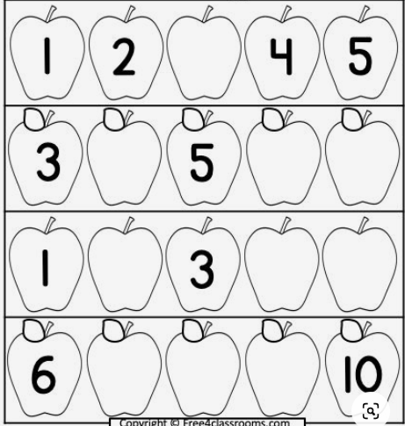
Group 2
Task 2: Complete the following number pattern.

Slide 47
Group 3
Task 1: Count the objects and write the total.

Slide 48
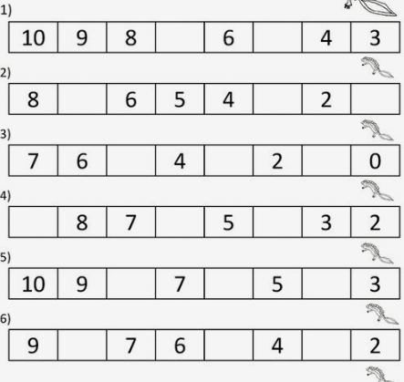
GROUP 3
Task 2: Complete the number pattern below.

Slide 49
Week 8
Describe, compare and order numbers 1-15 and recognise: more, less and equal to

Slide 50
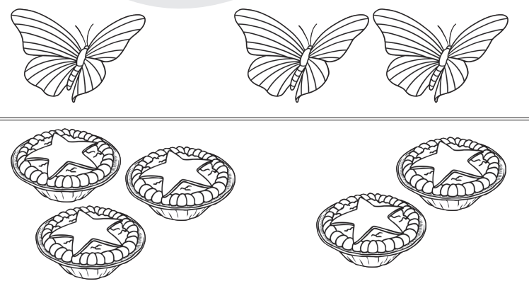
Group 1
Task 1: Say which set has more, less or equal objects.

Slide 51
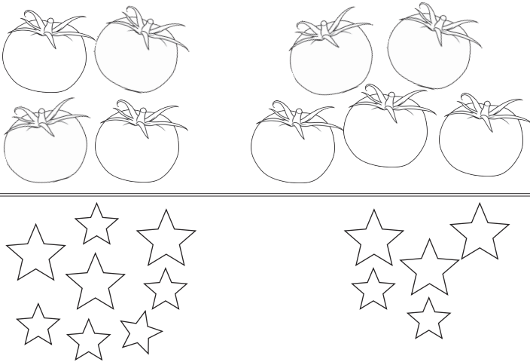
Task 1 cont…

Slide 52
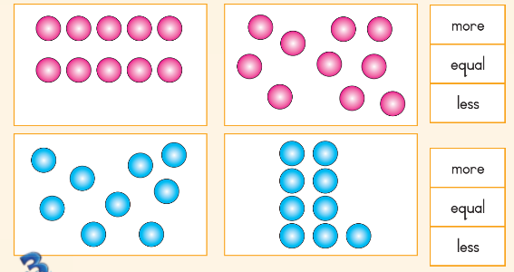
Group 2
Task 2: Say if second block is more, less than, or equal to the first block. Colour the correct answer.

Slide 53
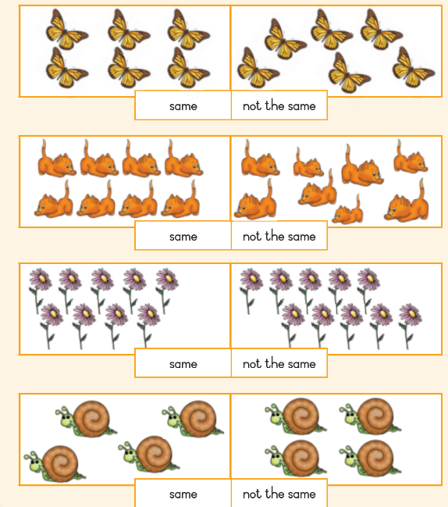
Group 3
Task 1: Match the objects on the left with objects on the right, colour the correct answer.

Slide 54
Week 9
Add the same number repeatedly up to 10

Slide 55
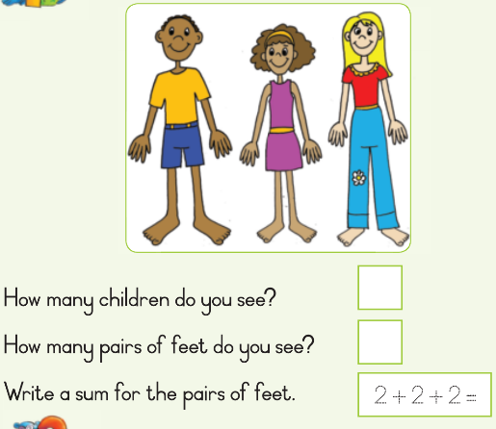
Group 1
Task 1: Answer the questions below.

Slide 56





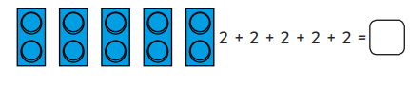
Group 2
Task 1: Write a sum of the following.

Slide 57
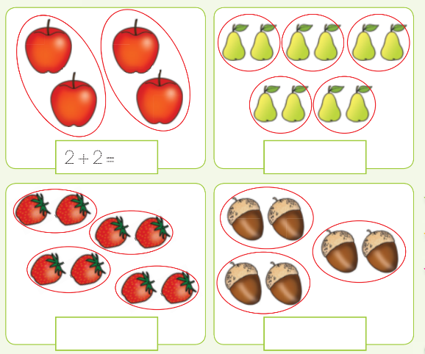
Group 3
Task 1: Write a sum of the following.

Slide 58
Week 10
Recognise and identify the South African coins, R1,R2, R5 and the bank notes R10, R20, R50, R100 and R200

Slide 59
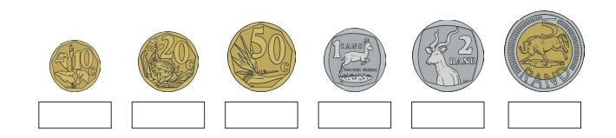
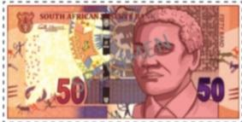
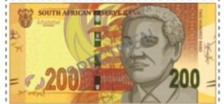
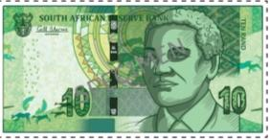
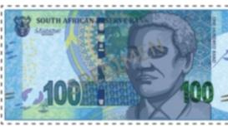
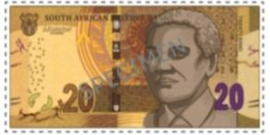
Group 1
Task 1: Say the correct value of each South African note.

Slide 60
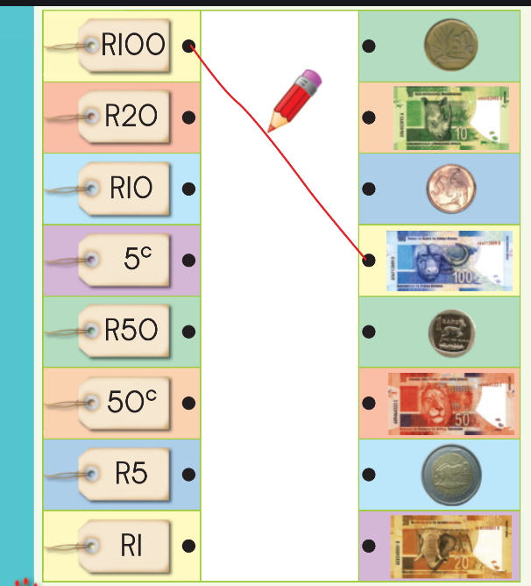
Group 2
Task 1: Match the amount with the money.

Slide 61
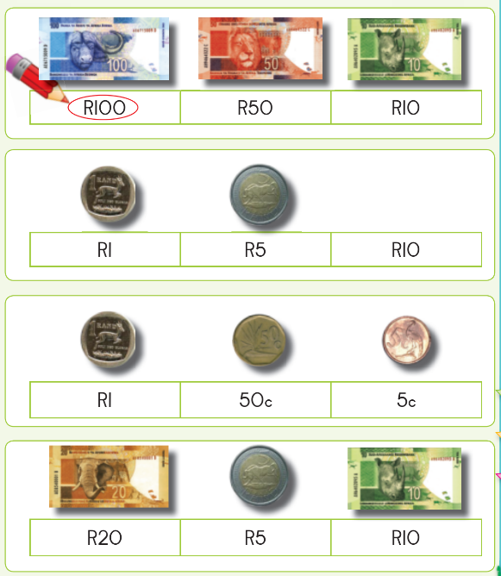
Group 3
Task 1:Circle the notes/coins that has a highest value.

Slide 62
Resources
www.k5learning.com
www. sparklebox.co.uk
www.twinkl.co.za
www.Pinterest.com
DBE Mathematics grade 1 book 1 and 2
DBE Mathematics grade 1 book 3 and 4

